Slide 1
Singleton design pattern

Slide 2


Our team
Nguyễn Hoàng Khôi
Vương Quốc Ấn
10421030
10421002

Slide 3
Table of contents
01
02
03
04
Overview
Definition
Benefit and application
Demonstration

Slide 4
01
Overview

Slide 5
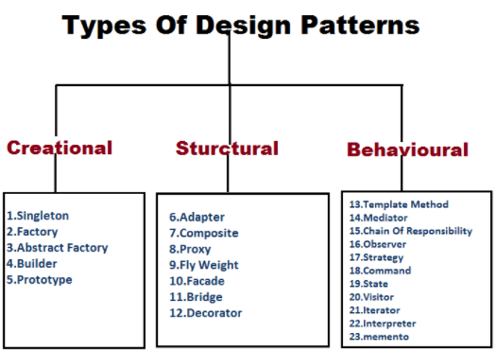
- Design pattern are categorized into 3 main groups
- Singleton pattern is a Creational pattern

Slide 6
02
Definition

Slide 7


Slide 8
Idea:
private:
Singleton() = default;
public:
static Singleton& getInstance() {
if (uniqueInstance == null) {
uniqueInstance = new Singleton();
}
return uniqueInstance;
}

Slide 9
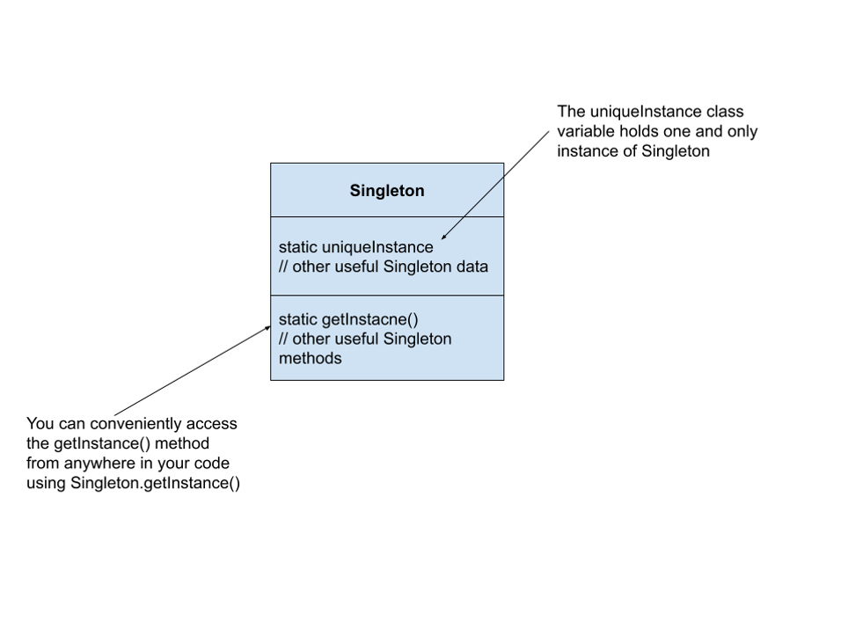
Class Diagram

Slide 10
03
Benefit & application

Slide 11
Benefits
01.
02.
Provides a single point od access makes it easy to control access to the class and its resources
Allow lazy initialization: which is important for resource intensive objects.

Slide 12
Application
Use the Singleton pattern when there must be exactly one instance of a class, and must be accessible to clients from a well-known access point

Slide 13
04
Demo
Simple Singleton Program

Slide 14
Thank You

